Slide 1



Annie: Anime Fan Assistant App

Slide 2
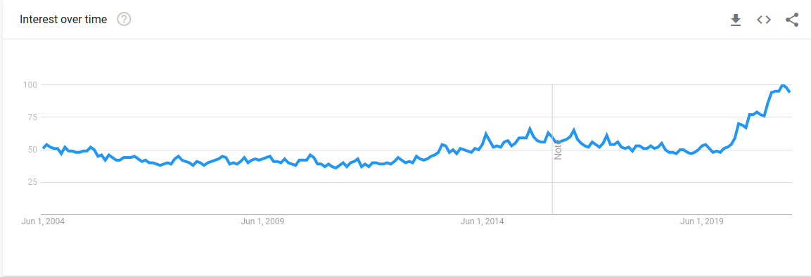

Interest overtime for Anime worldwide

Slide 3
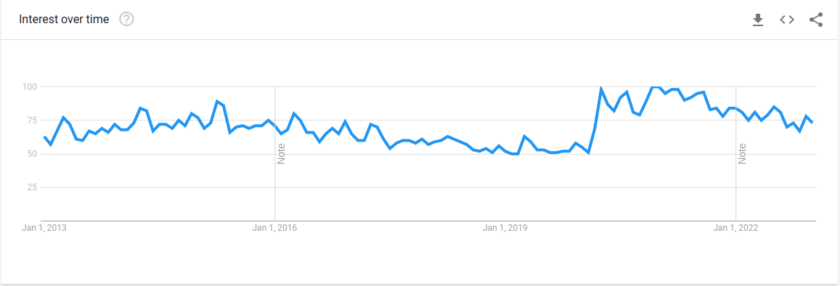
Interest overtime for Anime in the Philippines

Slide 4
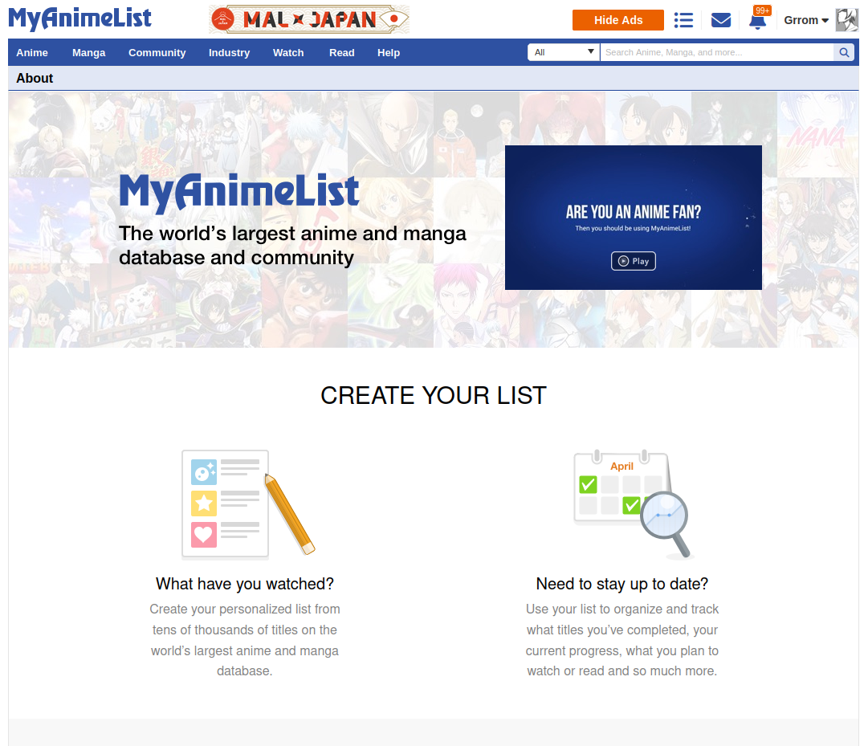

Slide 5
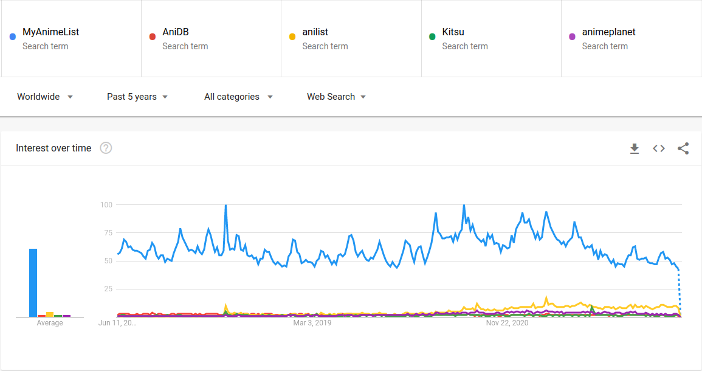
Why we chose MyAnimeList integration

Slide 6
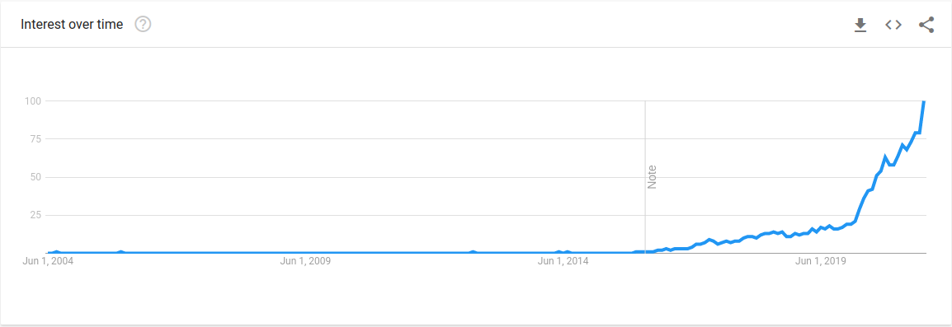
Interest overtime for Discord

Slide 7

Objectives
To help Anime fans get titles of anime shows by analyzing a screenshot of the anime.
To help anime fans to find Anime series that they love or to discover series they might enjoy through recommendations.
To provide a calendar for seasonal Animes that the users may want to watch.
Help Anime fans to familiarize themselves with the Japanese writing systems.

Slide 8
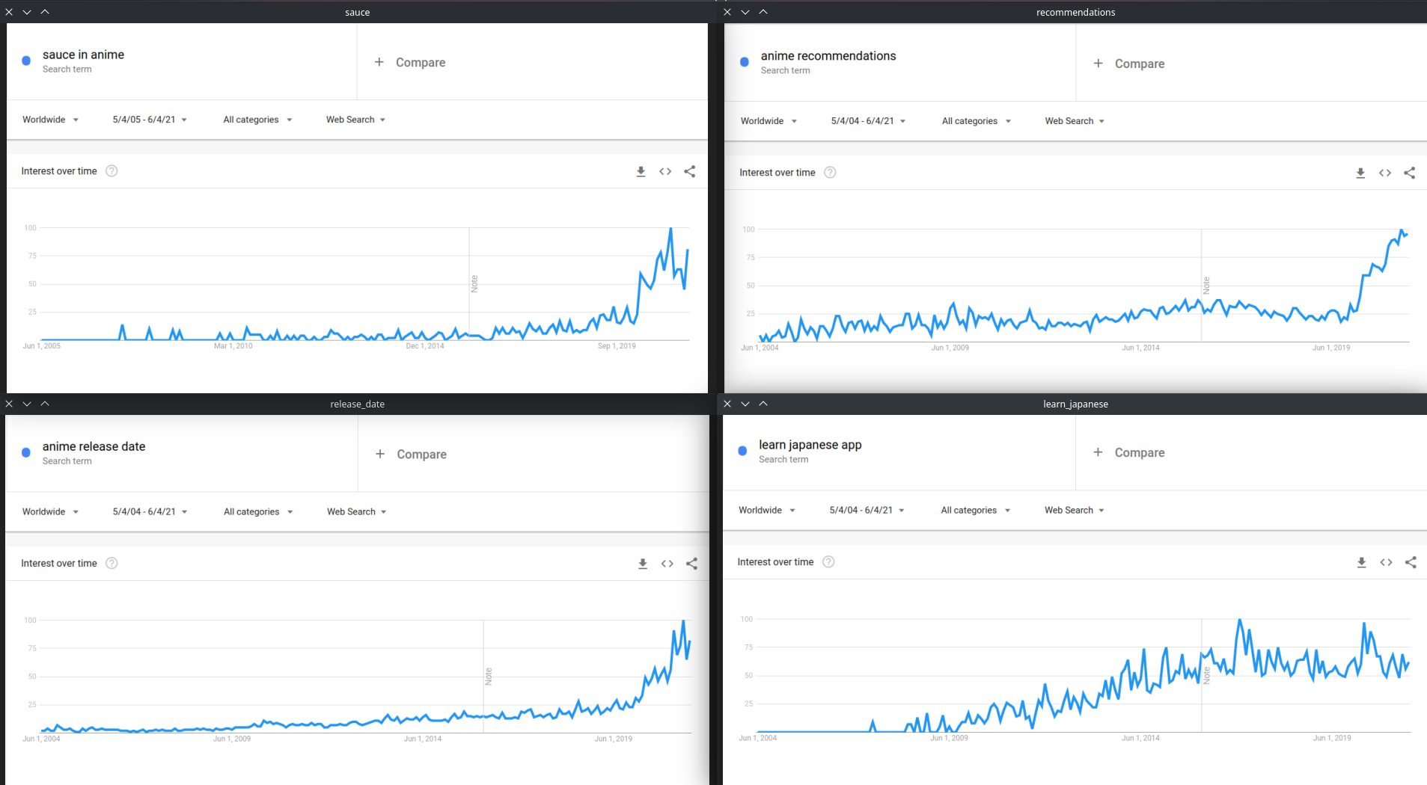

How did we choose our objectives?

Slide 9

Scope and Limitation

Slide 10
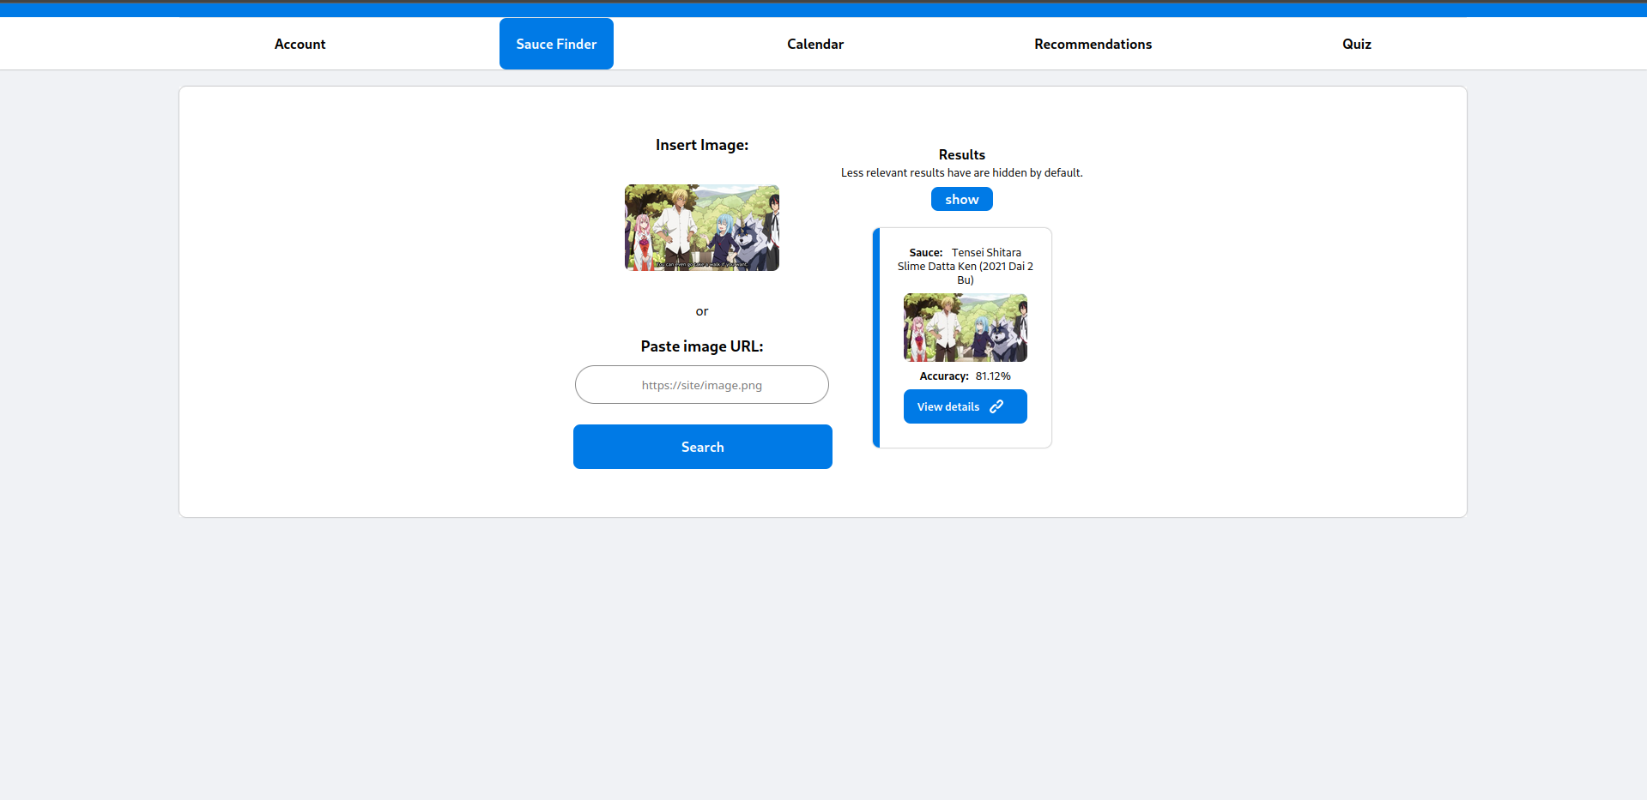
scope
The system has a reverse image search called “sauce finder”.
limitation
The system will struggle to recognize images that are edited, cropped, filtered or has really low resolution.

Slide 11
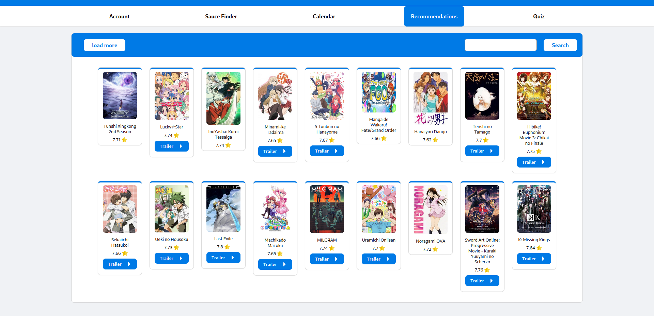
scope
Anime recommendation feature give users anime recommendations by analyzing the user’s watch history.
limitation
If the user does not link their MyAnimeList account to the system, then the system has no way of getting the user’s watch history and will simply default to recommending high rated and popular animes.

Slide 12
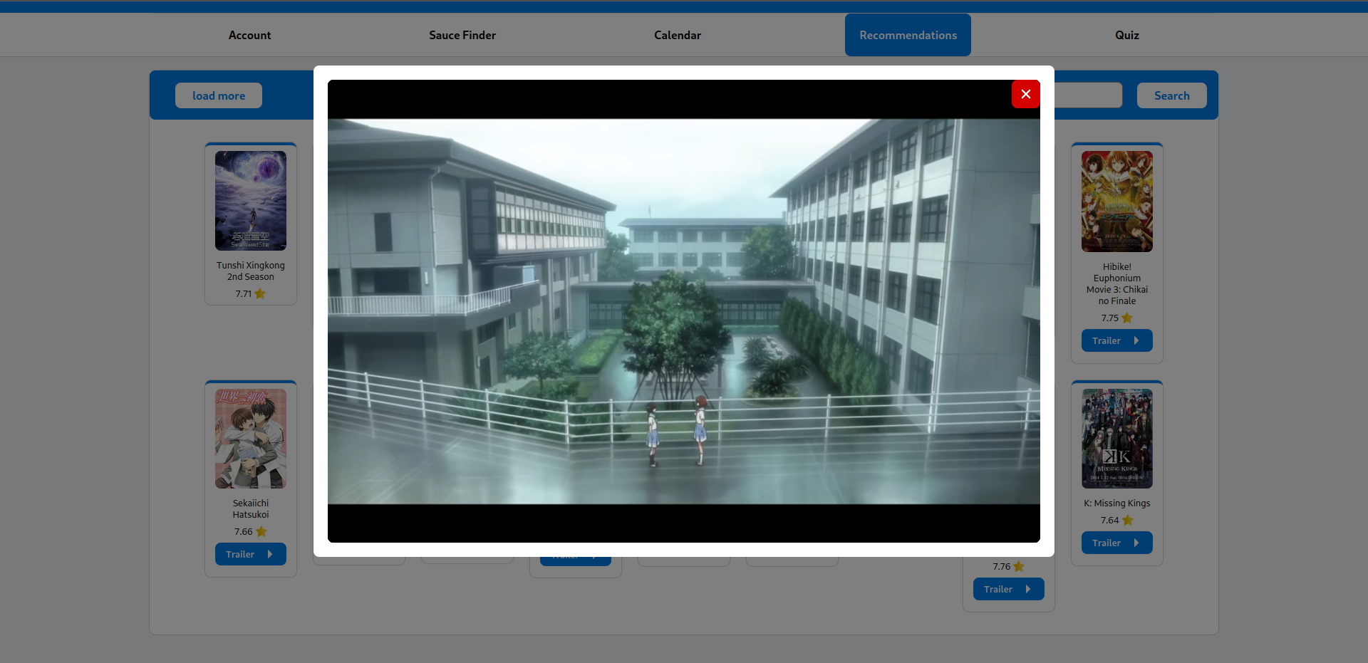
Trailer of the anime.

Slide 13
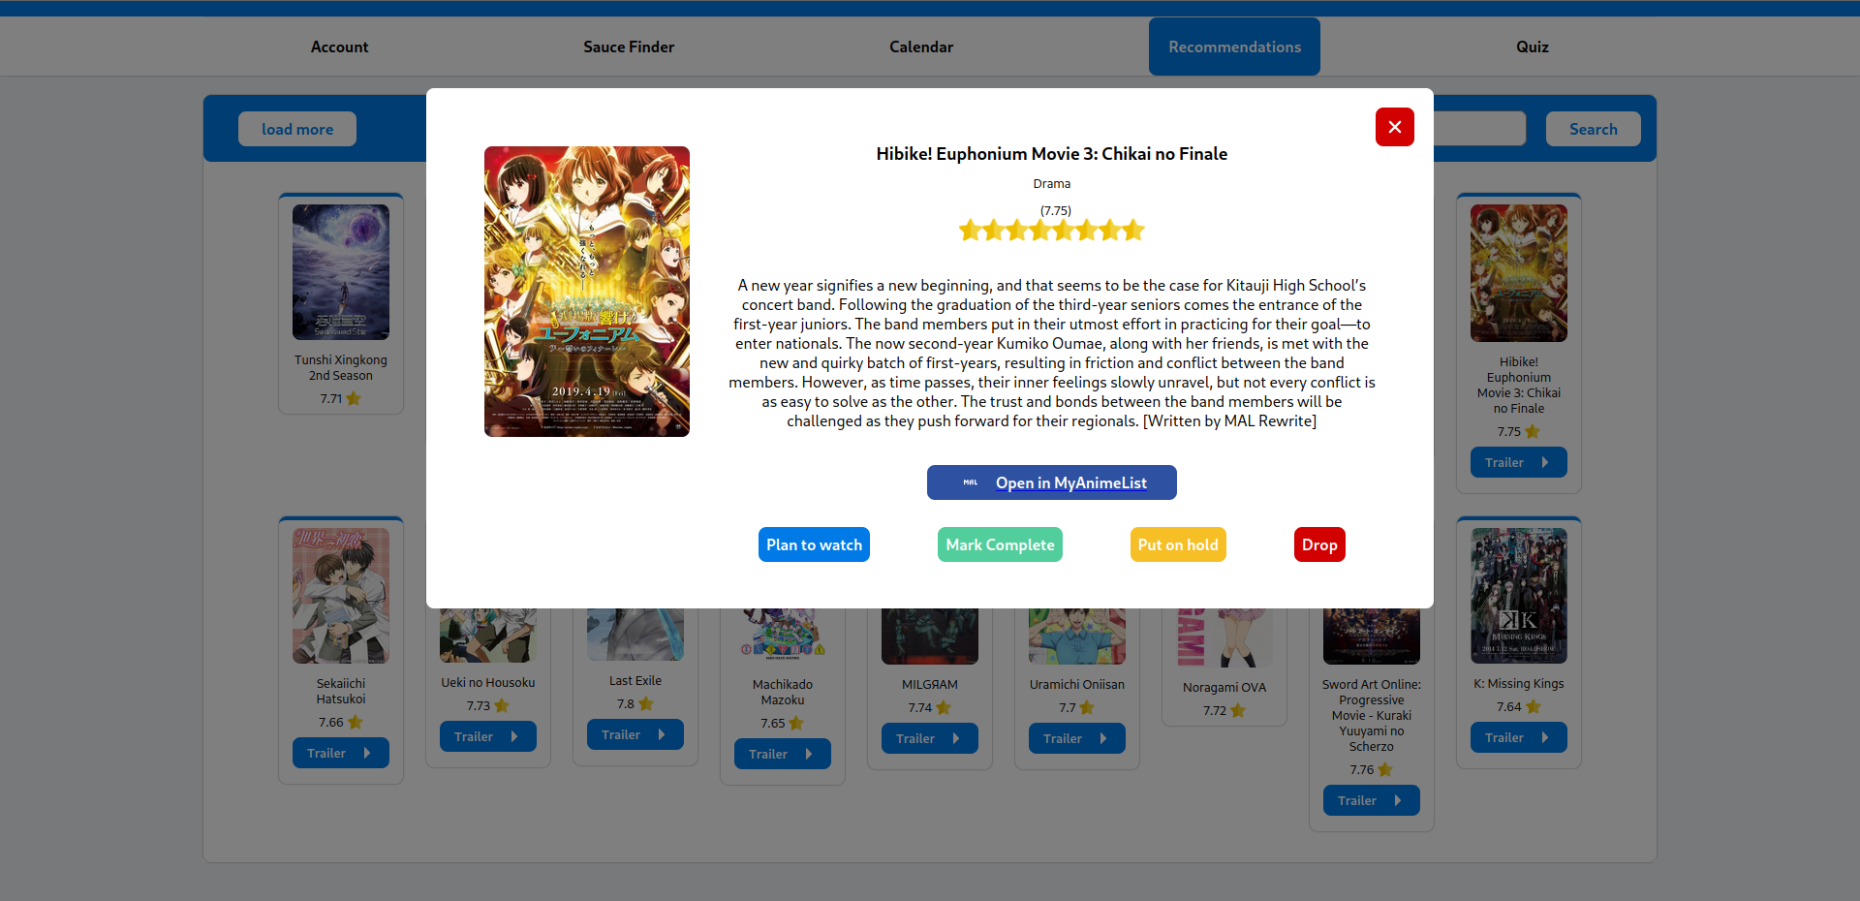
Details about the anime.

Slide 14
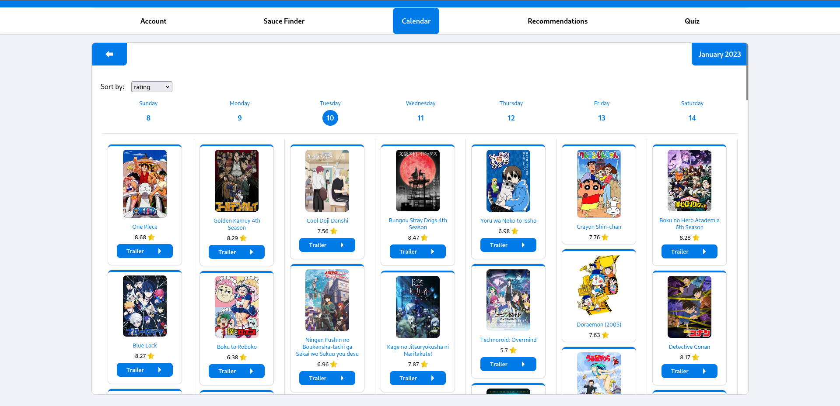
scope
The Anime calendar plots the date of release of airing anime episodes in a calendar.
limitation
The schedules will be synced with Japan release dates which may not be the same with international release dates since many international streaming sites have different release dates/times.

Slide 15
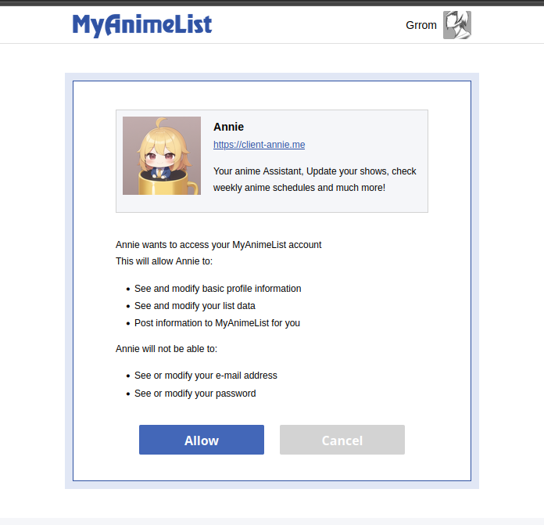
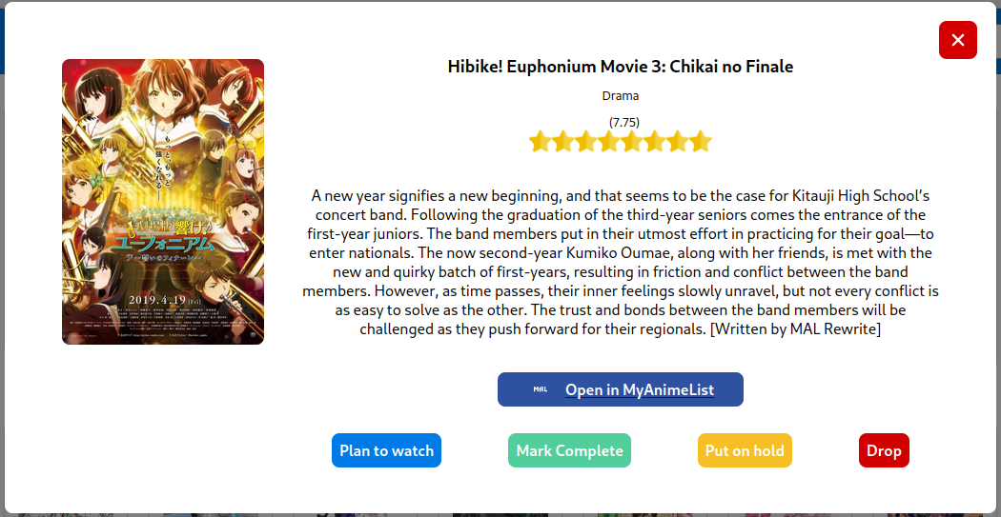
The system allows users to update their AnimeList or watchlist through the MyAnimeList integrations. This requires the users to link their MyAnimeList account.

Slide 16
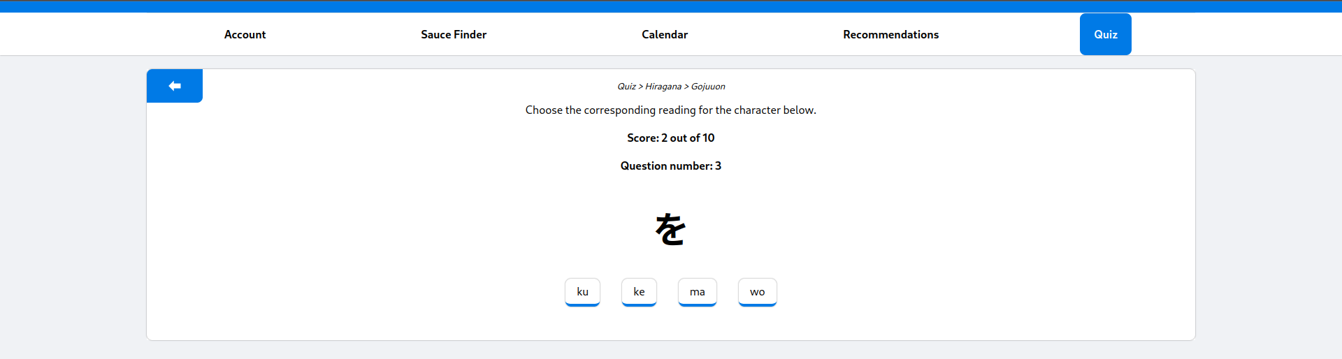
scope
The system has a Japanese writing system character recognition quiz
limitation
The quiz is only a character recognition quiz and does not include a comprehensive language course.

Slide 17
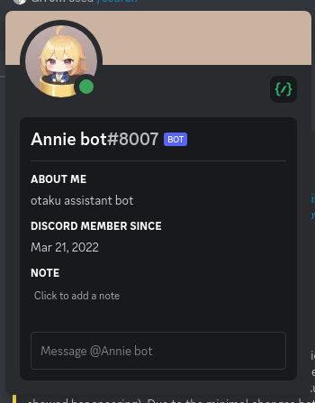
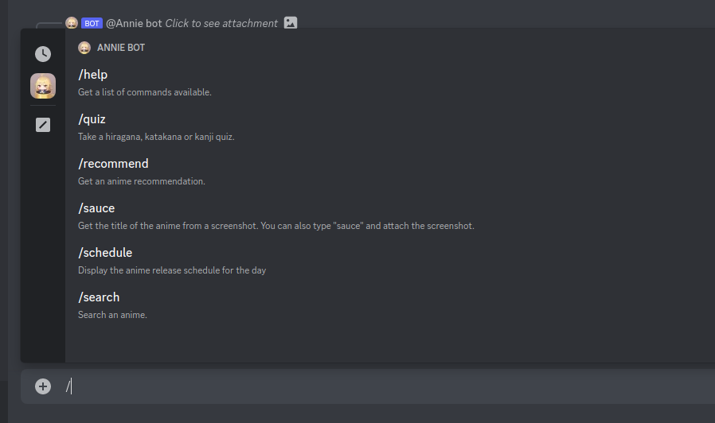
Discord Bot

Slide 18
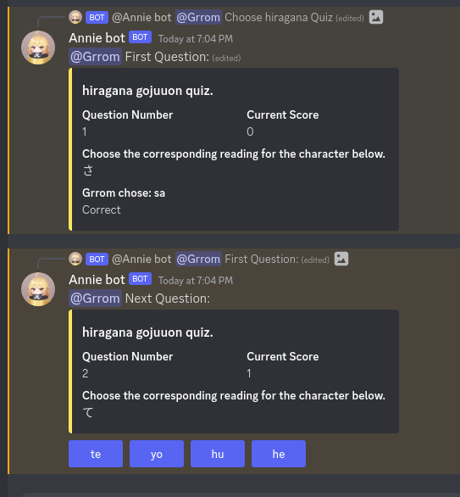
Quiz / mini game

Slide 19
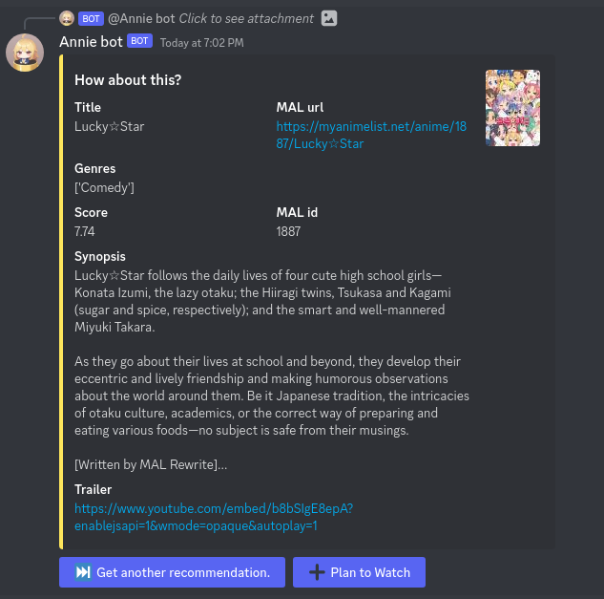
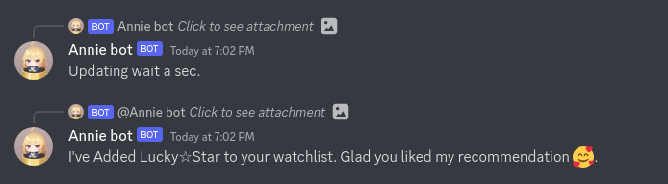
recommend

Slide 20
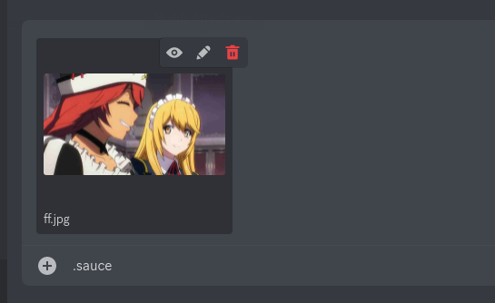
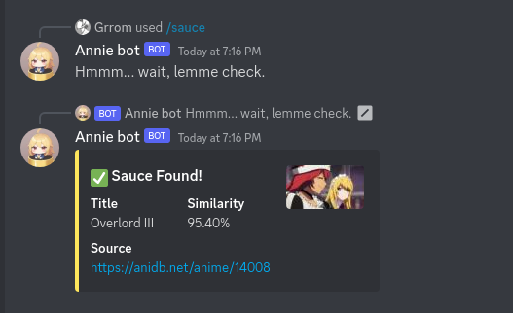
Reverse image search ( sauce finder )

Slide 21
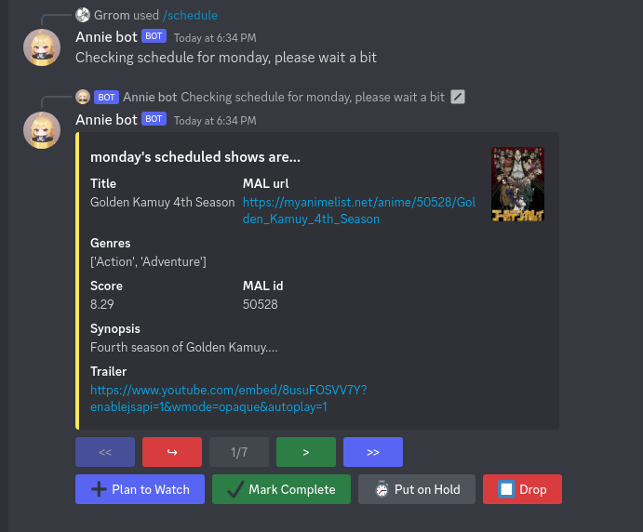
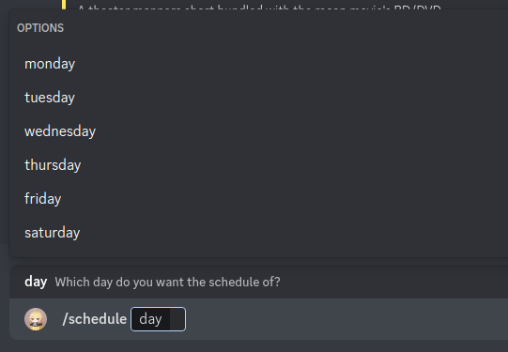
Schedules

Slide 22
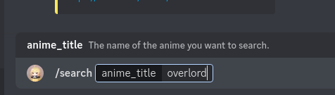
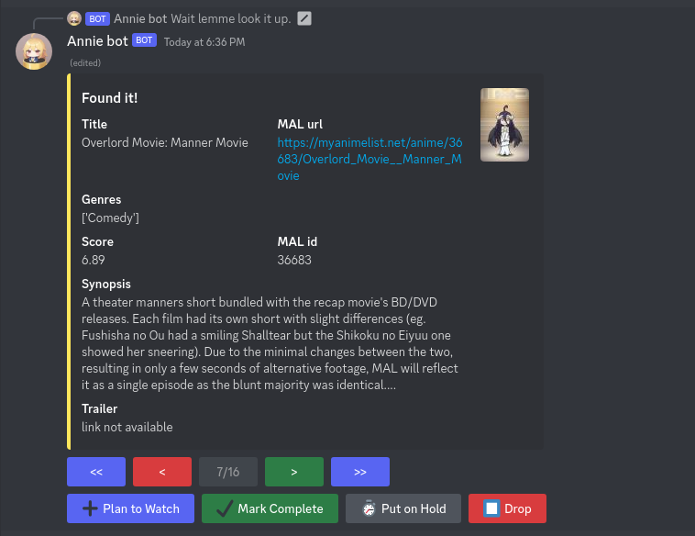
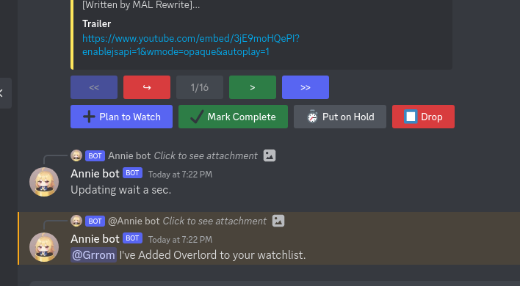
search anime

